Slide 1


Social Networks analysis in French higher education
By: Amr MOHAMED
mohamedamr@cy-tech.fr

Slide 2
Introduction
In this presentation, we are going to go through the internal and external juries of higher education institutions in France in 2019 and 2020, and discover how the internal and external juries in France are composed, and how often do the members of external juries work with different institution, Finally, we are going to discover how COVID-19 pandemic affected the juries of higher education compositions,

Slide 3
Methods

Slide 4
Methods
In our Social Networks Analysis, we are going to use the following techniques:
Multipartite
Community Detection:
Louvain Algorithm
Infomap Algorithm
Centrality Measures:
Betweenness Centrality
Edge Strength
Eigenvector Centrality

Slide 5
Results

Slide 6
Multipartite Social Networks

Slide 7
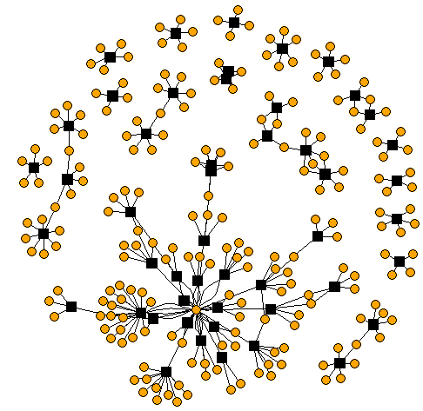
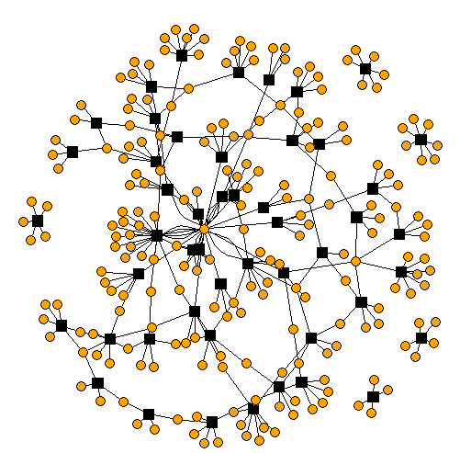
Social networks Within higher education in 2019
Internal members
External members

Slide 8
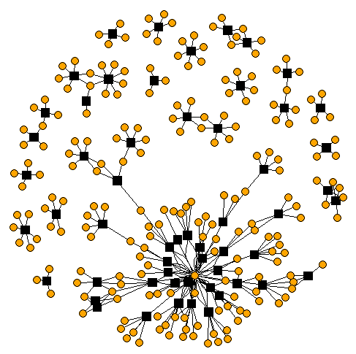
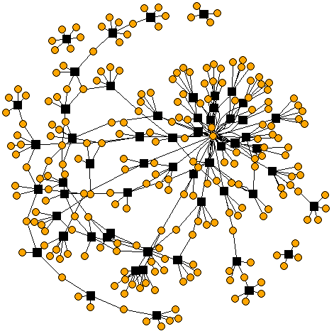
Social networks Within higher education in 2020
Internal members
External members

Slide 9
Social networks Within higher education in 2019
Internal members of juries in 2019 and 2020 years appear to be in closed small communities of 5-6 members with an exception of a surprisingly big network of internal members that has the highest number of members in both years.
External juries' members in 2020 had less edges on average than those of 2019 meaning that there weren’t many interactions between external members of juries 2020 hypothetically as a reason of COVID-19,

Slide 10
Community detection

Slide 11
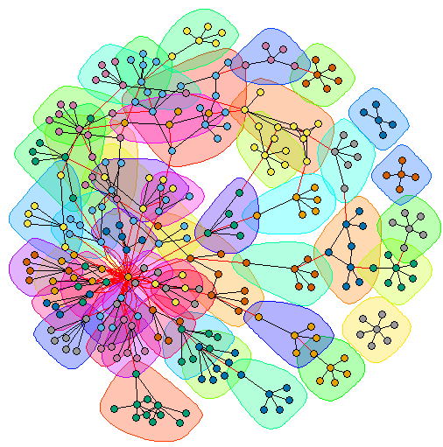
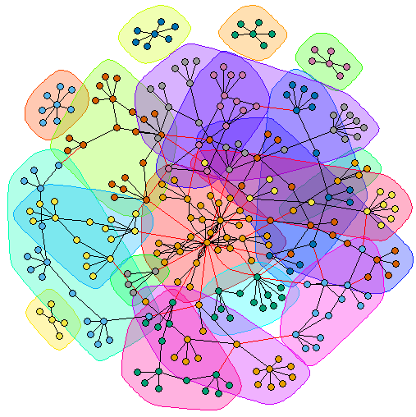
Social networks Within higher education External juries' community detection in 2019
Using the Infomap Algorithm
Using The Louvain Algorithm

Slide 12
Social networks Within higher education External juries' community detection in 2019
Both algorithms, The Infomap and the Louvain algorithms, have found the same number of communities (44 communities).
The Infomap algorithm detected more defined communities with less overlapping between the different communities than the Louvain algorithm.
From both graphs, we can see that there were few juries of external members that were working in closed juries without overlapping with other juries, but we can as well see through the overlapping communities. that some members worked in 3-4 different external juries.

Slide 13
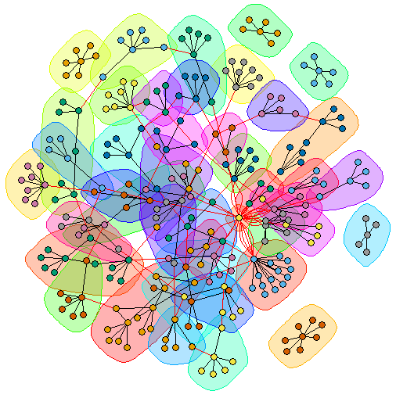
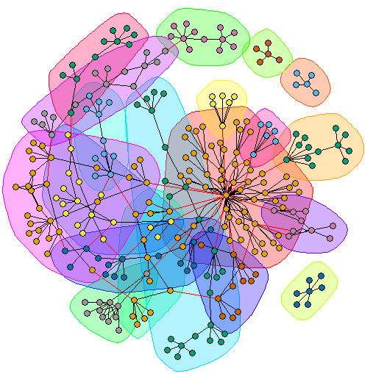
Social networks Within higher education External juries' community detection in 2020
Using the Infomap Algorithm
Using The Louvain Algorithm

Slide 14
Social networks Within higher education External juries' community detection in 2020
Surprisingly, The Infomap algorithm detected 48 communities compared to 19 communities detected by the Louvain algorithm.
From the Louvain algorithm graph, we can see that since there weren’t many communities detected, a lot of overlapping between the communities occurred, which means that in 2020, some members of the external juries worked for exceptionally more juries(more than 3-4 juries as in 2019).

Slide 15
Centrality measures

Slide 16
Betweenness centrality
Betweenness centrality measures the number of times a node lies on the shortest path between other nodes.

Slide 17
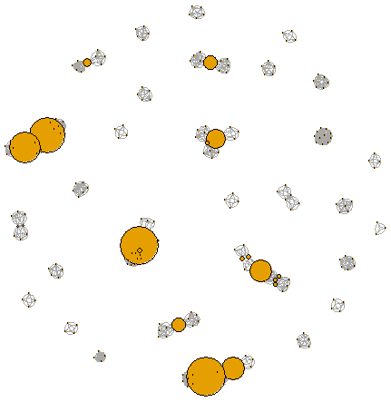
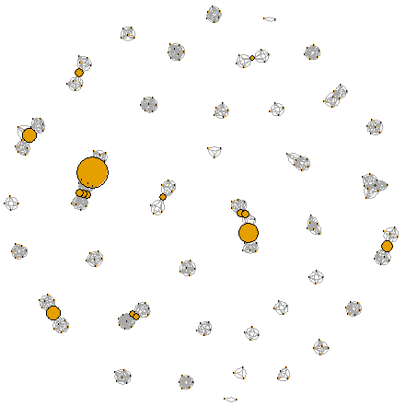
Betweenness centrality within social networks of members of internal juries
2019
2020

Slide 18
Betweenness centrality within social networks of members of internal juries
In 2019, there were more central nodes with higher betweenness between the internal juries than in 2020.
The previous observation supposes that on average, the supervisors which participated in many internal juries with many other supervisors have participated in fewer internal juries in 2020.

Slide 19
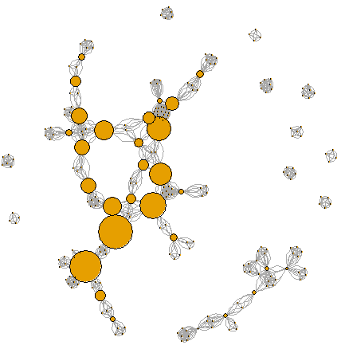
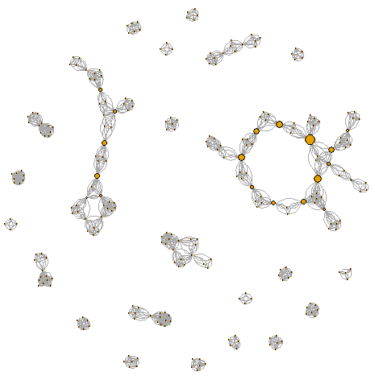
Betweenness centrality within social networks of members of External juries
2019
2020

Slide 20
Betweenness centrality within social networks of members of External juries
In 2019, there were many more central nodes with high betweenness between the internal juries than in 2020.
Central nodes with high betweenness in 2019 joined many external juries together through them, but in 2020, as those nodes almost disappeared, those connections between the external juries disappeared consequently.

Slide 21
Edge strength
Edge strength is the to number of interactions between two nodes.

Slide 22
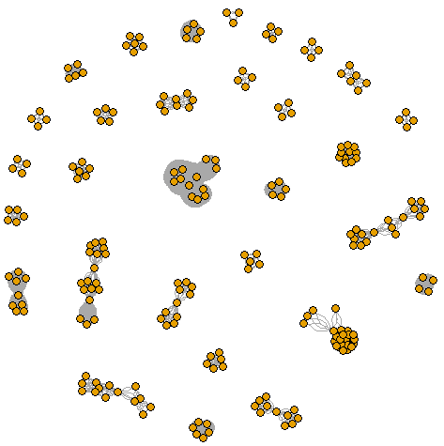
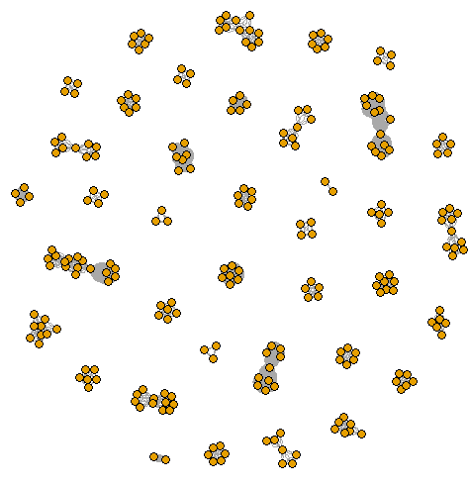
Edge Strength within social networks of members of internal juries
2019
2020

Slide 23
Edge Strength within social networks of members of internal juries
In 2019, there was higher edge strength on average between the different internal juries than in 2020, and that is probably because of the decrease in the total number on internal juries between 2019 and 2020 as a reason of COVID-19.

Slide 24
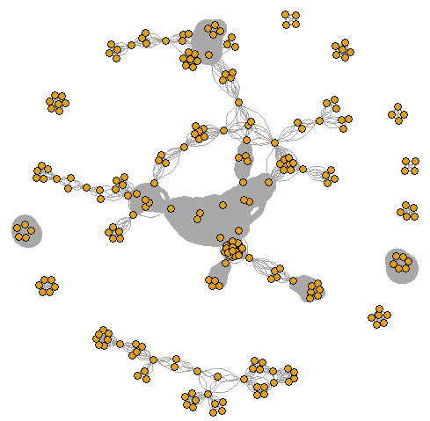
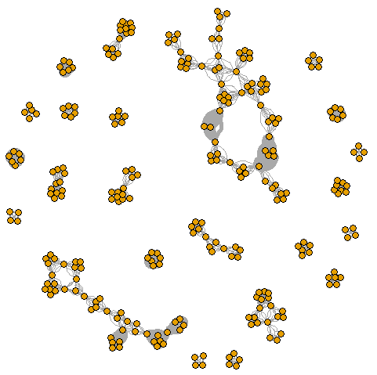
Edge Strength within social networks of members of External juries
2019
2020

Slide 25
Edge Strength within social networks of members of external juries
In 2019, there was much higher edge strength on average between the different external members of juries than in 2020, and that is probably because of COVID-19 and the difficulty for the external member of juries to participate in many different juries of different institutions.

Slide 26
Eigenvector centrality
Eigenvector centrality measures a node’s influence based on the number of links it has to other nodes in the network, then goes a step further by considering how well connected a node is, and how many links their connections have through the network.

Slide 27
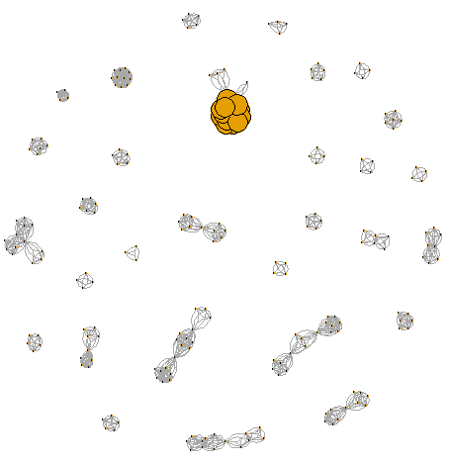
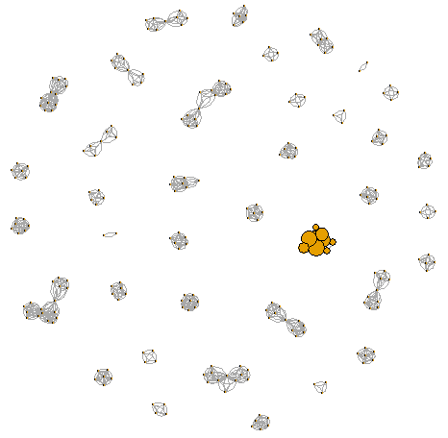
Eigenvector centrality within social networks of members of Internal juries
2019
2020

Slide 28
Eigenvector centrality within social networks of members of Internal juries
In 2019, the was a big central internal jury, with members’ nodes that have very high eigenvector centralities, and that is because those members have participated in many internal juries with each other and with other supervisors from the same institution.
In 2020, we can see that the eigenvector centrality of those nodes decreased slightly probably because of COVID-19 as the total number of juries decreased in 2020.

Slide 29
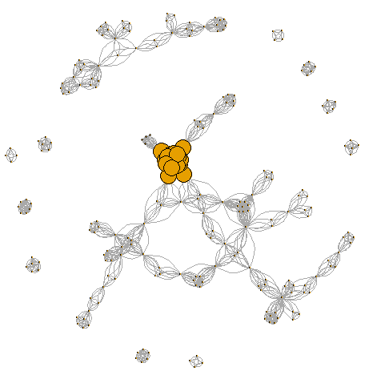
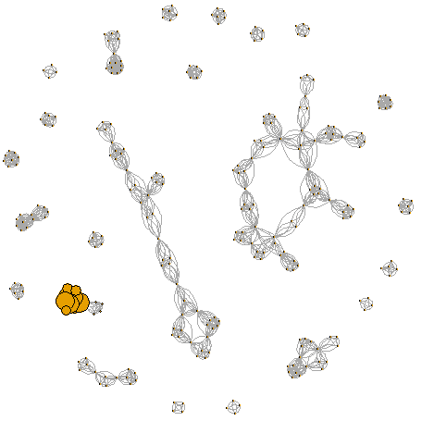
Eigenvector centrality within social networks of members of External juries
2019
2020

Slide 30
Eigenvector centrality within social networks of members of External juries
In 2019, we can see a group on external juries’ members centered in the middle of the network with nodes of a high centrality, and long edges that extends to a lot of neighbor juries, Those nodes have very high eigenvector centralities as they participated in many external juries.
In 2020, we can see that the centralities of those nodes decreased as well as the number and the length of their edges as a consequence of the COVID-19 pandemic.

